Slide 1
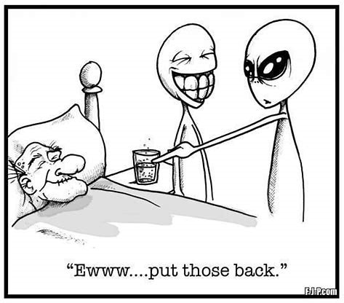

Slide 2
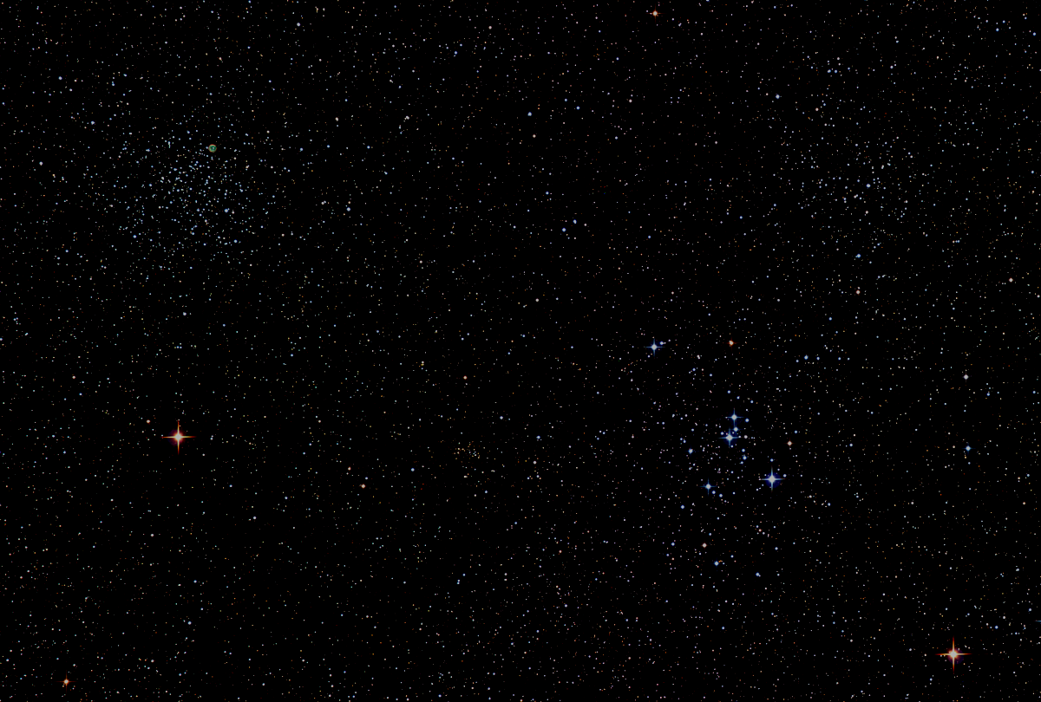

Howard
Astronomical
League
19
October 17, 2019
Notes:
Howard Astronomical League, June 21, 2018

Slide 3
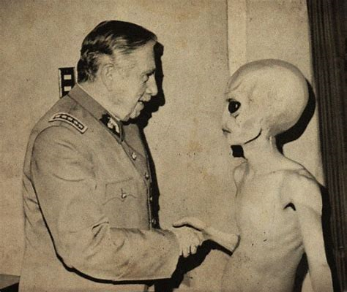
Introductions

Slide 4
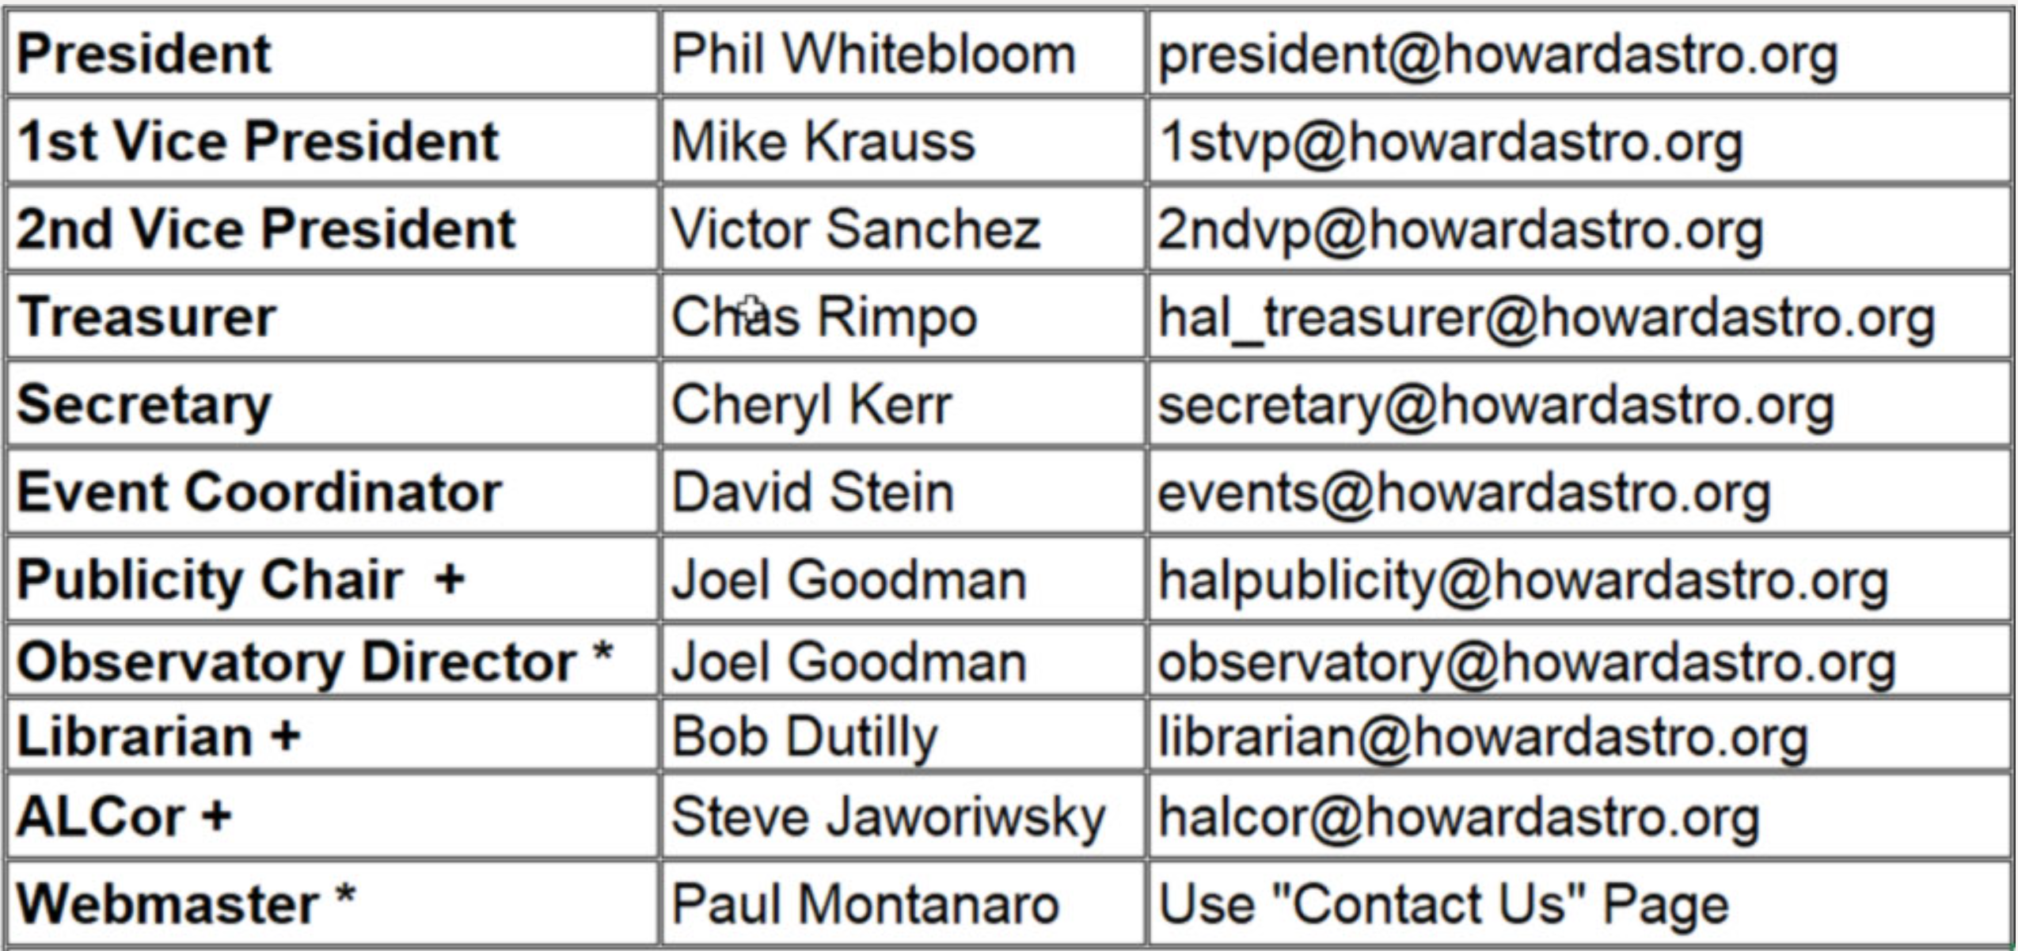
Officers Reports

Slide 5
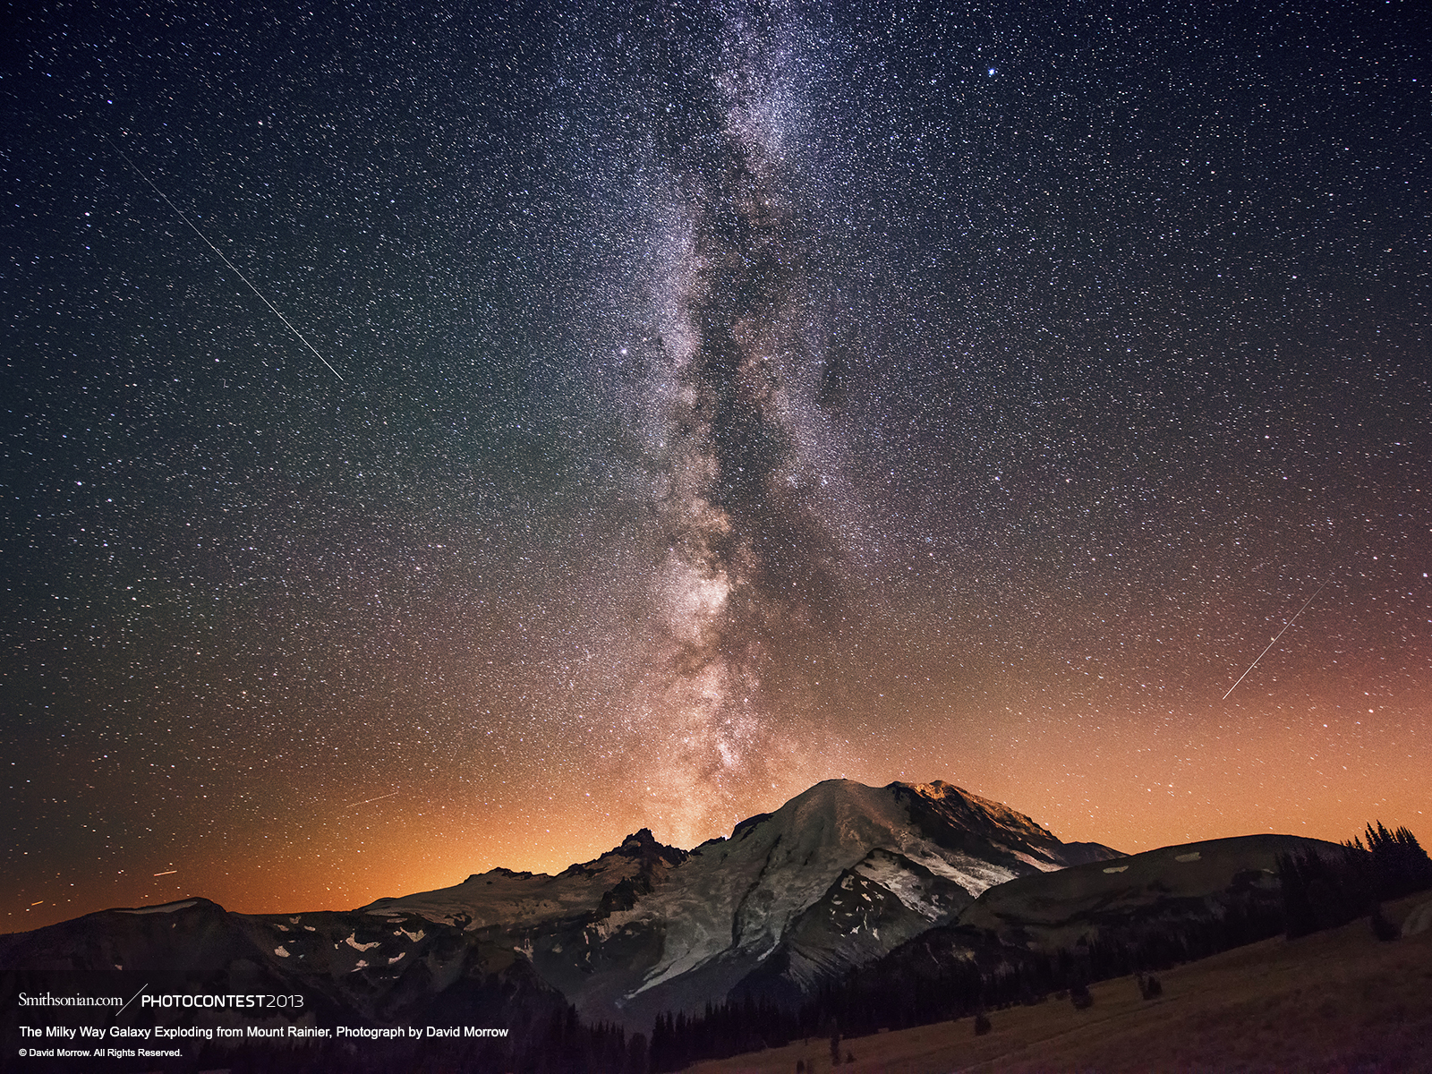
INTERESTING
STARS

Slide 6
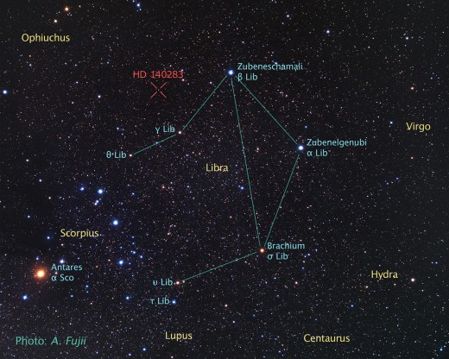
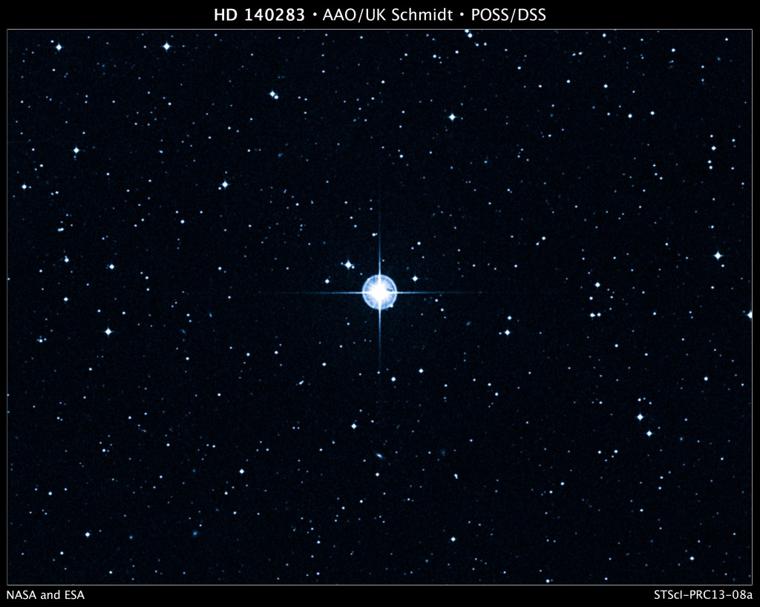
HD 140283
The Star That's Older Than The Universe!
Now that sounds impossible. How can a star be older than universe? But believe it or not this star, HD 140283, is older than Universe according to the calculations. It is estimated that this star is 14.46 ± 0.8 billions years old, whereas the universe is 13.79 ± 0.021 billions years.

Slide 7
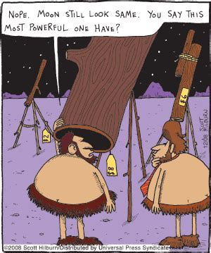
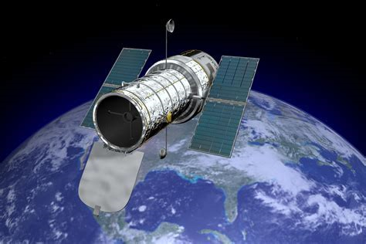
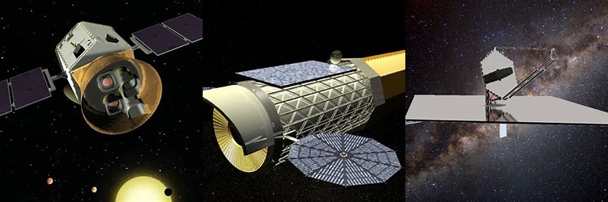
It’s time once again for:
Astronomy
Past
Present
Future

Slide 8
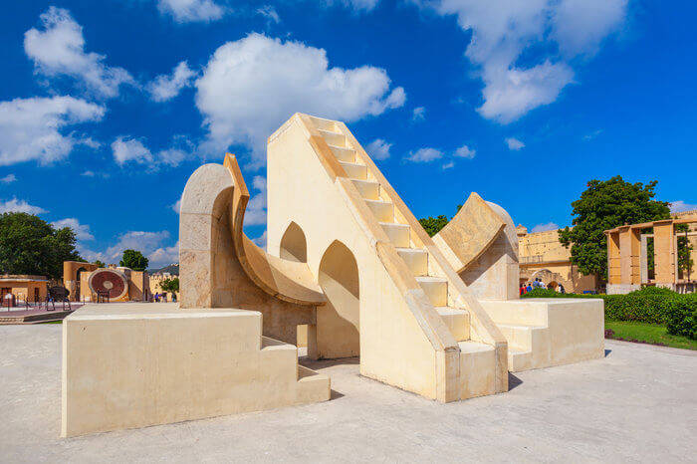
1734
Jantar Mantar Jaipur
The World’s Largest Sundial
Built by the Rajput king Sawai Jai Singh II in 1734, Jantar Mantar, Jaipur is an astronomical observatory, which features the world’s largest stone sundial. India has five of them, and the largest one is in Jaipur.
PAST

Slide 9
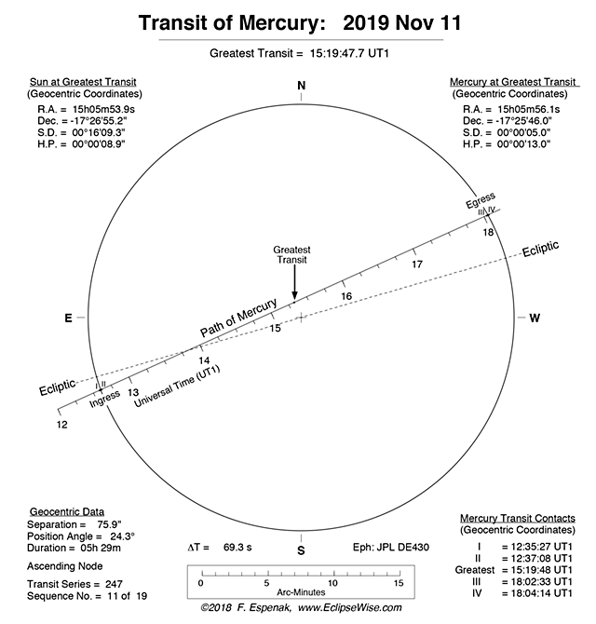
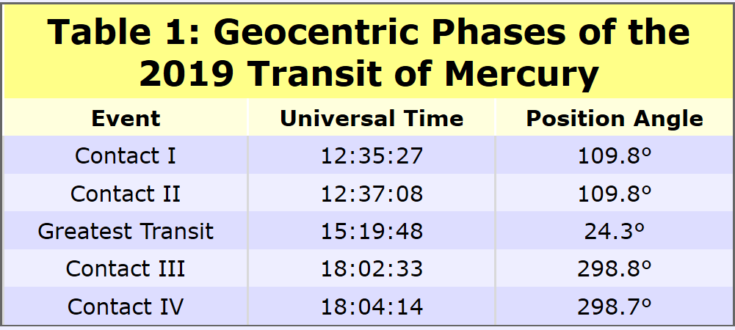
Transit of Mercury
November 11, 2019
P
R
E
S
E
N
T
On Monday, 2019 November 11, Mercury will transit the Sun for the first time since 2016. The transit or passage of a planet across the face of the Sun is a relatively rare occurrence. As seen from Earth, only transits of Mercury and Venus are possible. There are approximately 13 transits of Mercury each century. In comparison, transits of Venus occur in pairs with more than a century separating each pair.

Slide 10

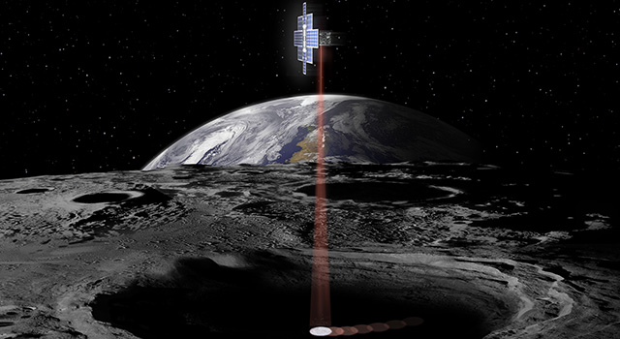
Lunar Flashlight
FUTURE
Type: Orbiter, Technology Demonstration
Status: Future
Launch Date: 2020
Launch Location: To be determined
Target: Moon
Destination: Moon
Lunar Flashlight is an exciting new mission concept that was recently selected by NASA's Advanced Exploration Systems (AES) by a team from the Jet Propulsion Laboratory and the Marshall Space Flight Center. Planned to launch on the Space Launch System's Exploration Mission-1 (EM-1) flight, this innovative, low-cost secondary payload concept will map the lunar south pole for volatiles and demonstrate several technological firsts, including being the first CubeSat to reach the Moon, the first planetary CubeSat mission to use green propulsion, and the first mission to use lasers to look for water ice.

Slide 11
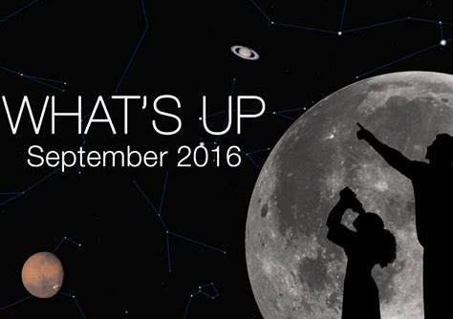
August 2019
A Special Feature from
“What’s Out Tonight”

Slide 12
September 2019 www.whatsouttonight.com
Clusters, Nebulae, Galaxies +
ly = Light year, a unit of distance. 1 ly = 6 trillion miles.
M57. Ring Nebula. Planetary Nebula that looks like a smoke ring. Smaller than what you might think. Estimated to be 1 ly in diameter and 2,000 ly away. Mag 9 / Spans 76" or 1.3’.
Brightest Stars
Altair. In AQUILA. Magnitude +0.9. Distance: 19 ly. Diameter: 1.9 times the Sun’s.
Capella. Rising in AURIGA. Magnitude +0.1. Distance: 42 ly. Diameter: 15 times the Sun’s.
Deneb. In CYGNUS. Magnitude 1.3. Distance: 3200 ly. Diameter: 222 times the Sun’s.
Mirach. In ANDROMEDA. Magnitude 2.1. Distance: 199 ly. Diameter: 89 times the Sun’s.
Mirfak. In PERSEUS. Magnitude 1.8. Distance: 592 ly. Diameter: 64 times the Sun’s.
Polaris. In URSA MINOR. Magnitude 2. Distance: 431 ly. 2,400 times brighter than the Sun. Vega. In LYRA. Magnitude +0.02. Distance: 25 ly. Diameter: 2.4 times the Sun’s.
Alpha Persei Cluster. Distance: 600 ly / Diameter: 31 ly / Mag 1.2 / Spans 3° / 30 stars.
Andromeda Galaxy. Companion to our Milky Way Galaxy. Distance: 2,400,000 ly / Diameter: 120,000 ly / Mag 3.5 / Spans 3° x 1°.
Coathanger Cluster. 10 stars shaped like a bar-type coathanger. It spans 2° and it stars are 150 ly away.
Double Cluster. Two side-by-side clusters. Distances: 7,200 ly / Diameters: 63 ly / Mag 3.5 / Span 1° / 320 stars total. Best in a telescope.
IC4665. Cluster. A large sprinkle of stars. Distance: 1,400 ly / Diameter: 17 ly / Mag 4.2 / Spans 40' / 30 stars.
M15. Globular Cluster. Distance: 34,000 ly / Diameter: 122 ly / Mag 6.2 / Spans 13’.
M11. Wild Duck Cluster. Distance: 5,600 ly / Diameter: 23 ly / Mag 5.8 / Spans 14' / 200 stars.
M13. Favorite Globular Cluster. Distance: 21,000 ly / Diameter: 104 ly / Mag 5.8 / Spans 17’.
M34. Large Cluster. Distance: 1,400 ly / Diameter: 14 ly / Mag 5.2 / Spans 35' / 60 stars. Try with binoculars, too.

Slide 13
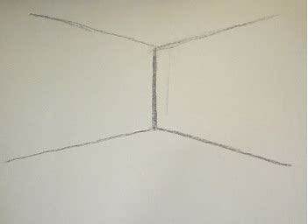

Visual Observers
Corner

Slide 14
Tonight’s Guest Speaker
Pete Sparacino
Electrical Engineer – Goddard Space Flight Center
Title: "Restore-L: Proving Satellite Servicing"

Slide 15
Member Astrophotos, Sketches, and Paintings

Slide 20
Forest Arnold

Slide 23
Upcoming Events
Oct 21-27: Chaos Falls Star Party – Stauton River State Park
November 2: Public Star Party – Alpha Ridge
November 11: Mercury Transit – Beginning 7:00AM
November 17-18: Leonids

Slide 24
Next month’s meeting is on Thursday, November 21st, 2019 at 7 PM
Peter Gural
TBD

